Slide 1

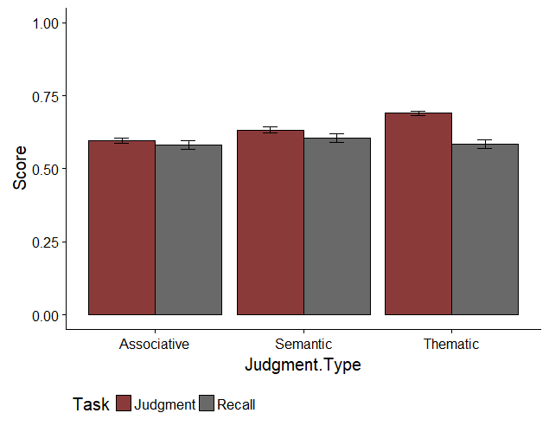
Modeling Memory: Exploring the Interaction Between Associative, Thematic, and Semantic Overlap
When Predicting Judgments and Recall
Nicholas P. Maxwell & Erin M. Buchanan, Missouri State University
Abstract
Previous work conducted on judgments of associative memory (JAM) has shown these judgments to be highly stable and that they generalize well across different contexts (Maki, 2007a; Maki, 2007b; Valentine and Buchanan, 2013). While traditionally JAM studies have focused on judgments of associative memory, the present study builds upon this work by extending the JAM paradigm to include semantic and thematic judgments, while controlling for several types of single word norms. Judgment ability and recall performance were predicted by the three-way interaction of semantic, thematic, and associative word-pair norms, but the type of judgment did not affect recall or judgments. Additionally, we explored which single word norms best predict recall and judgments.
Results
Interactions – Simple Slopes Recall
Recall
Predictor | β (SE) | z | p
FSG | 1.956 (0.271) | 7.223 | < 0.001
COS | 0.097 (0.137) | 0.706 | 0.480
LSA | 0.656 (0.220) | 2.976 | 0.003
FSG:COS:LSA | -15.473 (5.002) | -3.093 | 0.002
Judgments
Predictor | β (SE) | t | p
FSG | 0.293 (0.029) | 10.066 | < 0.001
COS | 0.178 (0.015) | 11.972 | < 0.001
LSA | 0.091 (0.024) | 3.819 | < 0.001
FSG:COS:LAS | 2.629 (0.606) | 4.337 | < 0.001
Method
Participants
221 participants were recruited from Amazon’s Mechanical Turk.
Stimuli
63 word pairs of varying associative, semantic, and thematic relatedness were created from the Buchanan et al. (2013) word norm database. Forward Strength (FSG) was used to measure association, semantic overlap was measured with Cosine (COS), and thematic relations were measured with Latent Semantic Analysis (LSA).
Single word norms were grouped into three classes: Lexical information (i.e., word length, POS, morphemes, syllables), neighborhood connections (i.e., orthographic and phonographic neighborhoods), and rated properties (i.e., age of acquisition, familiarity, valence).
Procedure
First, participants were presented with word pairs and were ask to judge how related they believed each word pair to be based on its associative, semantic, or thematic relatedness. This section was divided into three blocks, with each block beginning with a set of instructions explaining the type of relationship to be judged. Judgments were made on a scale of zero to 100, with zero indicating no relationship between items. Each block focused on one of the three types of judgments, and the order of instructions and judgment blocks was counterbalanced, resulting in each word-pair receiving judgments for each of the three types of relationships. Participants then completed a short distractor task before moving on to a cued recall task.
Analysis
Maximum likelihood multilevel modeling was used to test the interaction between FSG, COS, and LSA when predicting participant judgments and recall while controlling for type of judgment. These models were chosen because they retain all data points and control for error correlations between participants. When analyzing recall, a logistic regression was incorporated into the model to account for the binary nature of recall.
Single word norms were entered into the models in a series of steps. The first model used lexical information as the IVs. Model 2 added rated properties, Model 3 added in neighborhood connections, and Model 4 added in the original network norms.
Significant three-way interactions were found between FSG, COS, and LSA when predicting judgments. This interaction replicated when predicting judgments while controlling for single word norms and when predicting recall while controlling for single word norms.
Note: All variables were mean centered. Three-way interactions are between FSG, COS, and LSA for recall and judgments. Main effects and interactions shown are for single word models.
Interactions – Simple Slopes Judgments
Single Word Norms
Task | Predictor | β (SE) | Test Statistic | p
Recall
Judgment
Note: All variables were mean centered. Top three single word norm predictors for each task.
Mean Judgment and Recall Scores
Discussion
Note: Judgment scores have been divided by 100 so as to place them on the same scale as recall.
Contact: Nicholas Maxwell (maxwell270@live.missouristate.edu)
R code available at: https://osf.io/y8h7v/

